Slide 1

Database Start Here v3
Alan Lomax

Slide 2
Table of Contents
Section | Page #
Before you get Started | 3
The Welcome Screen | 5
The Built In Help System | 6
Options and Settings | 7
Entity Form Example | 8
Entity Form Changes from Previous Version | 9
Locations and RFID | 10
Additional Material | 11
Change Log | 23

Slide 3
Before you get Started
This database is written in and runs with Microsoft Access (2016). You only need Access if you want to modify the structure and the programming. To just use the database all you need is the Access ‘Run Time’ which is available from Microsoft here:
https://www.microsoft.com/en-ca/download/details.aspx?id=50040
The files that make up the system are described here:
This ‘Start Here Guide’ of course … it is recommended you review it before diving in
The Access Database Front End and Back End files. I recommend you name them as a pair. The default name is NEW_FE.accdb and NEW_BE.accdb but you can change NEW to be anything you like.
In general you always only ever run the FE file … and it ‘attaches itself’ to the back end. The first time you run the front end it may complain the back end is missing … and you simply navigate to the back end file and click on it.
There is an Executable file for use with the StaRFIshRail RFID system.
Additionally there is a library file (*.dll) that this executable needs and there is also a text config file
A software library called M2Mqtt.Net.tlb which is included. (for MQTT not Access)
IF YOU ARE UPGRADING see the caution note along with the list of changes in the change log at the end of this presentation.

Slide 4
Front End and Back End
You always work in the Front End (FE) using the menus and forms provided
Links
Forms, Reports, Programming
TABLES
Your Data is actually stored in the Back End (BE)
Front End
yourname_FE.accdb
Back End
yourname_BE.accdb
IMPORTANT:
Double Click the FE access database and it should launch automatically. It will test for and refresh the links to the BE. If the two files are not in the same place then it wont know where the BE is and you will be prompted to locate the file.
On the welcome page (the first page that comes up in the FE) there is a box on the top left that shows where the front end thinks the BE file is. If the box is green the file is found and the two are connected! Access wont ask again unless files are moved or renamed.
There is a button to deliberately break the connection and connect to a different back end (desirable when testing).

Slide 5
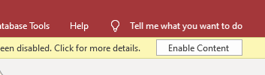
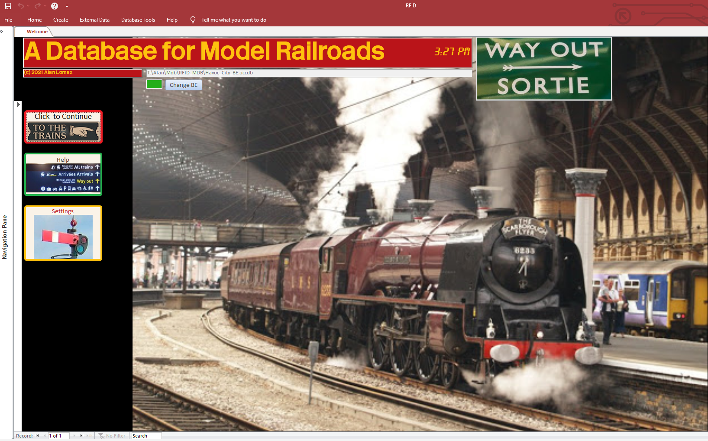
The Welcome Screen
You may get a security warning like this. Since this database relies on programming to work you must click enable content.
Click to change back end. REQUIIRED if back end box is not green.
Click to go to the main forms
Click here to Exit the program completely
(5) Look here to ensure box is green – which means the back end is connected.
** START HERE **
Some built in basic instructional pages
Change or review settings

Slide 6
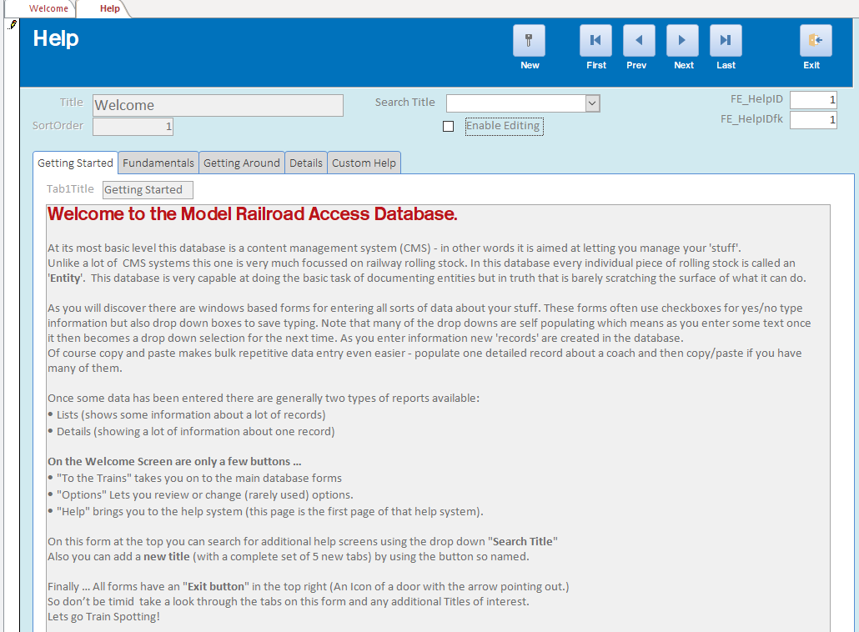
The Help Screen
Help data is saved in the database like other records are.
Each Record has a Title
For Each title there are 5 tabs worth of possible information
The title for each tab is also part of the data that is saved.
Editing is disabled by default but clicking here lets you add or edit the content.
Review the content on each of these 5 tabs for familiarity. You can always come back later.

Slide 7
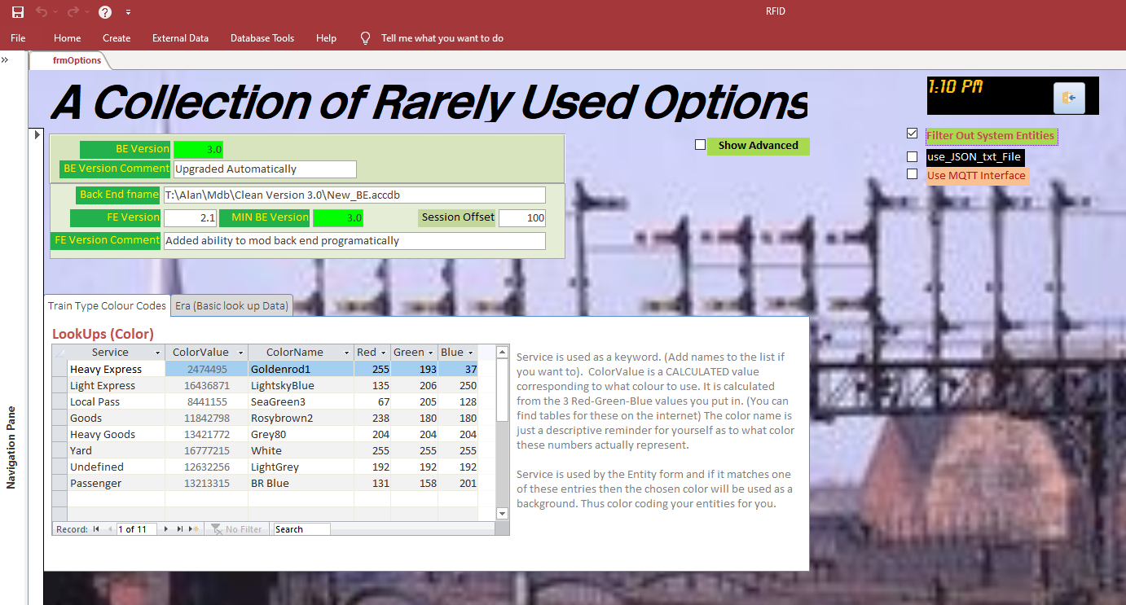
Options and Settings
Click to filter out system entities from normal use. They are still in the tables but most forms and reports don’t show them
Green is Good. BE Version and required BE Version match
Mikes fudge factor. This constant is added to the internal session number and result is the displayed session number.
Click to show more advanced information on this form. Initially this information is hidden just to minimize clutter.
Basic common definitions of each Era
After clicking show advanced scroll down on form to see very rarely used stuff.
On many forms and reports colour coding is used. Here the colours are defined using the common Red-Green-Blue set of 3 numbers (each 0-255). A color Value is calculated from these.

Slide 8
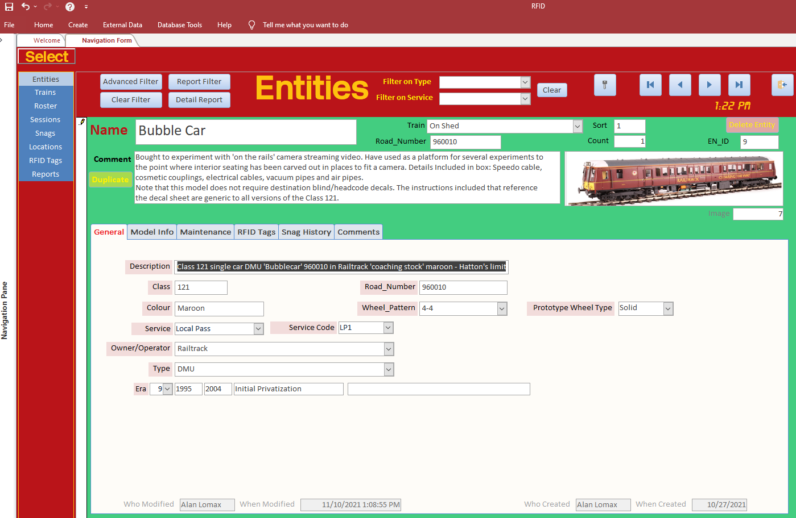

The Entity Form
Move through records in the database.
Choose the section you want to work with.
Entities is at Top (most common)
Create a new entry.
Back to the Welcome Screen
Delete Entity (you will be warned one last time)
Powerful Filtering. Button to clear filtering
If you are using this entity record to document a RAKE of something enter the quantity here. For example enter 5 for a rake of 5 coaches. (Only use this where the rake would bever be broken apart.
This button will duplicate the current Entity (all specs and image). Only the maintenance records and Snag reports are not duplicated.
The majority of fields have tool tips if you hover the mouse over them
Access provides built in tools to move through the records (same as the VCR type controls shown above)
You can also just type in a record number to go to it directly. There is a search box here too!
Most of the data fields have right click and filter capability which is also very powerful

Slide 9
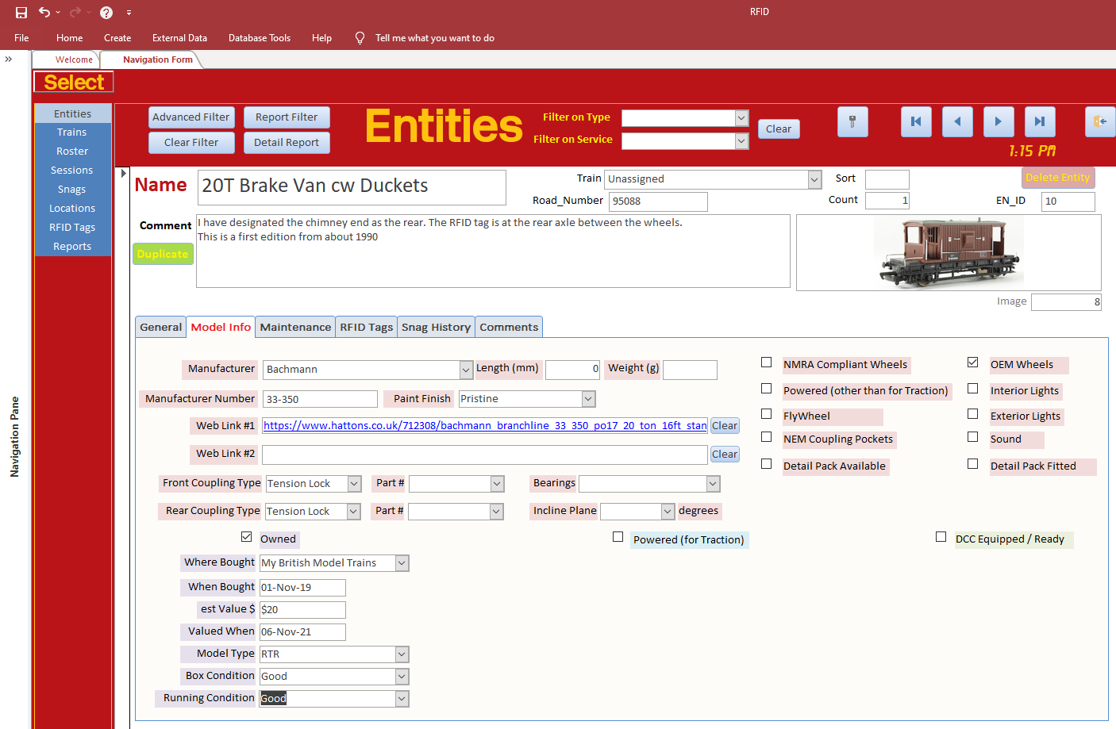
Entity Form (More)
Standardized proportions for images (4:1 ratio width to height)
Now with Two Weblinks. (eg vendor page and datasheet)
Weight of model in g
Double click to browse image library. (Also add a new image to the library, and pick the image for this entity.)
Both couplings individually spec’d with part number.
Many More Details
Tick box shows/hides relevant info
Generally a much more streamlined logical interface. With additional data fields and many cosmetic tweaks
Many More Details

Slide 10
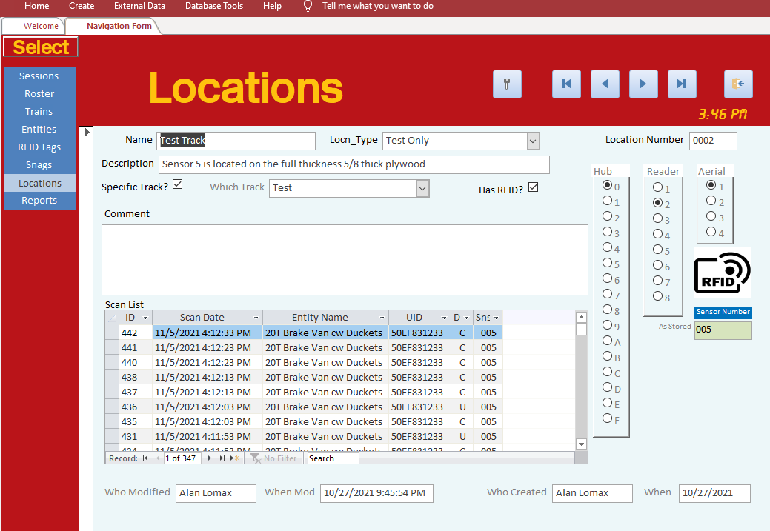
Locations and RFID
Generally the RFID TAGs are mounted on your rolling stock. Aerials to read those tags are mounted under the rails. Each Aerial connects to a reader, and each reader to a Hub. Within the database all of this is defined as a ‘location’. Below a location has been defined and the tick box ‘Has RFID’ is selected.
Ticking “Has RFID” will unhide the fields that allows a Hub reader and Aerial to be selected which results in a particular sensor # according to the design of the StaRFIshRail system.
The Bottom line is a location can have a sensor associated with it and if it does this page will show the Scans Records for that location..
Now shows entity (which has the Tag with given UID)

Slide 11
Additional Material
Additional material is FYI only

Slide 12
Database Main Table Design
TRAIN (TR_ID)
Entity (EN_ID)
(TR_IDfk)
RFID Tag (TAG_ID)
(EN_IDfk)
(TAG_UID)
RFID SCAN Table (SCAN_ID)
(Sensor, R/U, Tag_UID)
Link TR to RSTR (TR_IDfk) <> (RSTR_IDfk)
Link EN to RSTR (EN_ID) <> (RSTR_IDfk)
MTCE Log (MTCE_ID)
(EN_Idfk)
Location List (Locn_ID)
Snags (snag_ID)
(EN_Idfk SESN_IDfk)
Roster (RSTR_ID)
NOTES
A Train is just a named collection that may have one or more Entities associated with it.
An Entity can only belong to one Train at a time.
An Entity may have one or more RFID TAGs associated with it.
An RFID TAG can only belong to one Entity at a time.
An Entity may have one or more Service Maintenance records associated with it.
An Entity may have one or more Snag Reports associated with it.
A Roster just a named collection that may have one or more Trains and may have one or more Entities associated with it. Normally the Entities are just Locomotives but this is not required.
The same Train or Entity can exist in multiple rosters.
A Session is a specific operating session with a start time and end time (to be set loosely and wide).
A session may have one or more Rosters assigned.
A Location may have an RFID reader associated with it.
Link SESN to RSTR (SESN_IDfk) <> (RSTR_IDfk)
Session (SESN_ID)

Slide 13
Where to Now?
I recommend looking through the forms for familiarity.
During testing I created and deleted several dummy records. (Flying Scotsman theme)
You could do similar just create records to see where the info shows up on various forms and reports. You can delete the records when done to clean up the database.
The central pillar for the database is without a doubt the Entity. There are forms for entering data, reports for listing and reviewing the data plus many sub forms.
A sub form shows how one set of data relates to another .. for example a “Train” is composed of related “entities”, or an “Entity” has “Maintenance records”.
There are three entities that are ‘system’ related and as such are not really dummy records. They are named ‘Blank’, ‘System’, and ‘Unassigned’. Initially these entities are filtered out on mist forms and reports. (effectively ‘hidden’) There is an option on the settings screen to remove the filter and it is worth getting familiar with this behaviour.
All of these activities will help you get familiar with the database layout and operation.

Slide 14
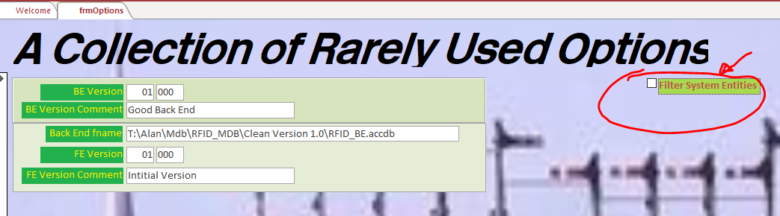
System Entities
Another system record is simply called ‘Undefined’ which is used when RFID tags are scanned for the first time. Your workflow to install RFID tags should go like this: a) document entity in database b) Attach tag to an entity (unknown UID at this point) c) scan entity / tag. When first scanned a new RFID tag is created and it will be assigned (in the database) to the ‘Undefined’ entity. In the database you look at ‘Undefined’ and then reassign this tag away from the ‘Undefined’ entity and over to the correct entity that you just built.
The final system entity is called ‘system’ and it can be used for logging maintenance records not about your model railroad stuff but about your system in general. You could of course create your own entities for keeping track of other items also.
The three system entities are not required to be visible. There is an option on the ‘options page’ to effectively hide the three system entities from your forms and reports. You tick the setting and then the next time you go to the entity form there will be three less entities. See below:

Slide 15
RFID MQTT and Access
This database was written with the ability to read and process RFID tags.
Specifically a small ‘client program’ is provided for subscribing to especially formatted MQTT messages and loading them behind the scenes into a back end. (Specifically to the table: tbl_JSON_Raw)
The RFID system used publishes MQTT messages up to every 1/10 of a second as tags pass over the aerials. The message consists of the UID of the tag, the sensor # (aerial) and also the type of read (A new read, a ongoing read, or a loss of read)
Additionally the RFID Hub will send a ‘keep alive’ message every 20 seconds.
If configured (by default it is turned off) you can ask the Database to auto start the client program on the options page. Generally it is best if you manually launch the client first to ensure it connects, subscribes and is receiving MQTT messages. Once verified to be properly configured only then should it be auto started.
For test purposes the client can also log the MQTT messages to a text file for analysis.

Slide 16
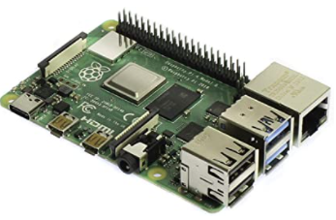

Database MQTT Interface (Unified View)
MS Access
Standalone EXE program
RFID SCAN Table (SCAN_ID)
(Sensor, R/U, Tag_UID)
MQTT Client Code
SQL Insert (JSON) One Line at a time from recordset
Append / Write one line to Access Table
Read JSON as a record set from tbl_json_raw processing and deleting Rows as we go. Do every 10 sec when main form is open.
User Interface
If not exist Create file
Append / Write one line
OR
tbl_JSON_raw
Each new row is a payload having all reads from previous 1/10 second
JSON Text file
Each payload on a new line
Each line has all reads from previous 1/10 second
Configuration Settings
MQTT_Config.TXT
This data path was only used during testing to load the JSON messages and test Access processing. A checkbox remains in options to reenable it.

Slide 17
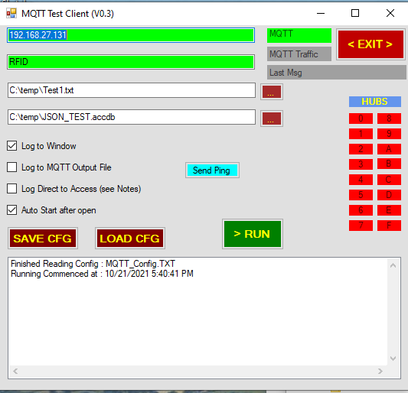
MQTT RFID Tool
Green when connected.
Red if disconnected
IP Address or URL of MQTT Broker
Green when connected.
MQTT Topic to subscribe to.
Green when subscribed.
If you don’t know what this is I can’t help you
Green when traffic in last 20 seconds.
Yellow if no traffic in last 20 seconds. Red if no traffic in 45 seconds
Name of Text file where payloads will be logged. (Can Locate using the button) Green when logging
Publishes “PING” to broker using Topic. Sending and receiving is captured in window below.
Time of most recent message
Name of Access BE Database where payloads will be logged.
(Can Locate using the button)
Green when logging
Which Hubs are reporting in. (0-F to match HUB address switch)
Green < 20 seconds
Yellow for > 20 seconds
Red for > 45 seconds
Log Payloads to List box.
Log Payloads to txt file.
Auto start on open
(once configuration file is set of course).
Log Payloads to Access
Manually start
Or restart if configuration has changed.
Load and Save Configuration file (All of the above settings). See MQTT_Config.TXT
List box for messages.
Also shows MQTT payload if Log to Window is checked.

Slide 18
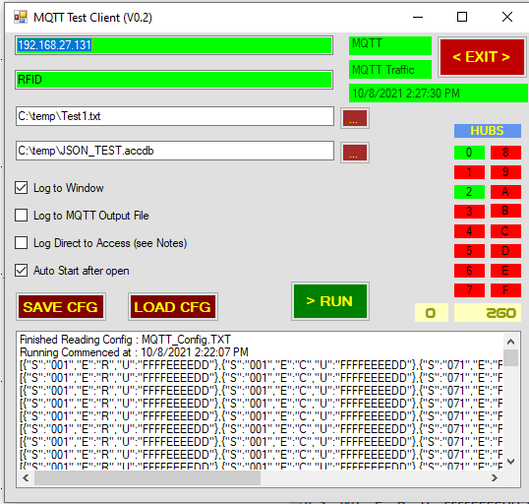
Viewing Hub Message Counts
Click Here and two additional boxes will appear below the Hub Status lights.
Click the box again to hide them away.
Select a HUB to monitor by clicking one of these boxes. Note Green hubs have sent messages in last 45 seconds. (Keep alive are sent every 20 seconds). Effectively this shows who is connected.
These two boxes show the currently selected HUB and the number of payloads received from that HUB.
Here Hub 0 has sent 260 messages.
This list box is effectively an output screen. Here it is showing ‘dummy’ MQTT payloads generated by a completely separate Python program and being published to a MQTT broker running on a Raspberry Pi

Slide 19
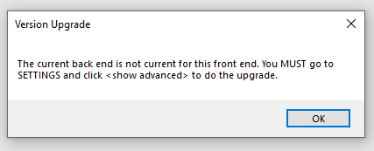
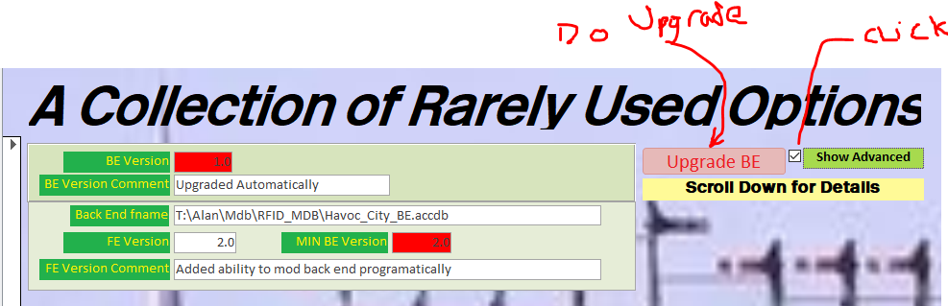
Changelog
CAUTION – If you are upgrading do NOT overwrite your back end database file.
You only need the new front end. The back end (with your data in it) will be upgraded in place.
When you start the new Front End it first checks your Back End version and you will get the message box below left if an upgrade is needed.
If you have several BE files you will need to connect to each BE and upgrade them one at a time. When complete the version numbers should be green once again.
Main Changes
Bug Fixes resolving issues found during testing
If you get a message box like shown at left then do these steps :
Click OK
Go to the settings screen
Click Show Advanced and
press the Button to upgrade BE

